Slide 1
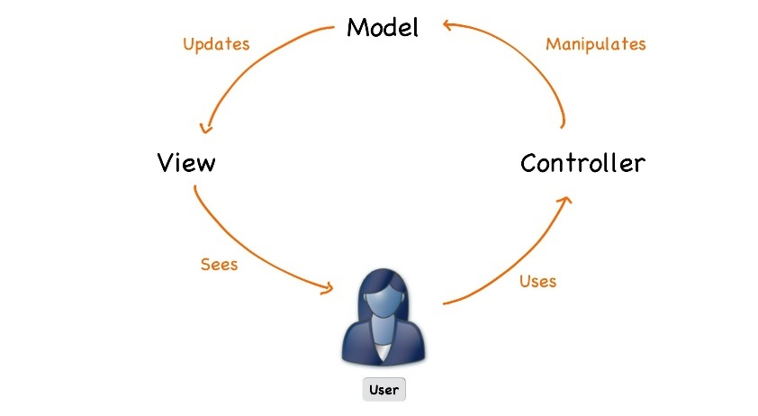



C# Web Basics
Course Introduction
SoftUni Team
Technical Trainers
Software University
http://softuni.bg

Slide 2
Table of Content
Course Objectives
Training and Team
Course Organization
Course Infrastructure
Evaluation Criteria

Slide 3
Questions
sli.do #csharp-web

Slide 4

Course Objectives

Slide 5
C# Web Basics
Web Fundamentals
HTTP Protocol
Custom Web Server
Custom MVC Framework
Custom View Engine
Authentication and Authorization

Slide 6
ASP.NET Core
Essentials of ASP.NET Core
Razor View Engine
Security and Identity
Project Architecture
Unit Testing
Control Flow
Deployment and Continuous Integration

Slide 7
Practical Programming Exam
1 practical problem for 4 hours
Implementing a simple web application with:
Custom MVC Framework
Custom Web Server
Part of the of Views
Solutions are evaluated by hand after the exam

Slide 8

Exam Demonstration

Slide 9


The Module Team

Slide 10
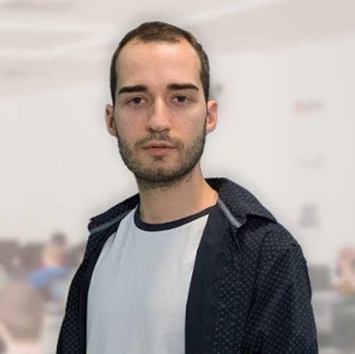
Module Team (Trainers)
Nikolay Kostov
Solutions Architect @ ZenCodeo
15+ years in the IT
Developer, Manager, Trainer, Architect
Аctive role in the development of the Judge platform - https://judge.softuni.bg/
Microsoft Certified Trainer
Personal blog: nikolay.it

Slide 11
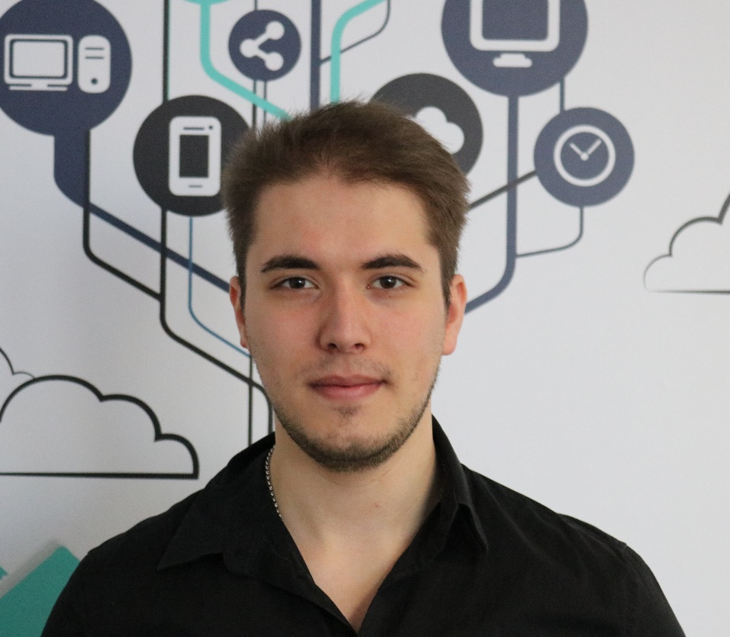
Module Team (Trainers)
Ivaylo Jelev
Training Team Leader @ SoftUni
5+ years in the IT
3+ years as a Technical Trainer @ SoftUni
Professional Problem Creator (Exam & Exercise Problems)
Interested in Game Development

Slide 12

Module Team (Materials & Resources)
Mirela Damyanova
Training Assistant @ SoftUni
Graduated Student from SoftUni
Loves helping students
Experience with ASP.NET and Angular 2
Interested in Blockchain & Algorithms

Slide 13
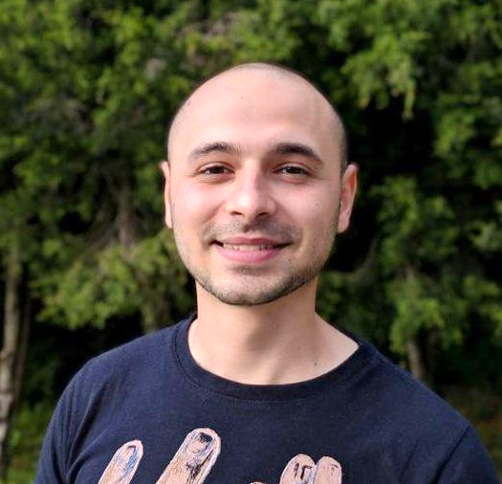
Module Team (Materials & Resources)
Stoyan Shopov
Team Lead @ SoftUni
Technical Trainer @ SoftUni
ASP.NET Web Developer
Experience with WebForms & WPF
Mountain lover

Slide 14

Course Organization

Slide 15
C# Web Module at SoftUni – Timeline
13-May-2019
16-June-2019
C# Web Basics
5 weeks * 4 times / week
12 credits
Start: 13-May-2019
Exam: 16-June-2019
Re-Take Exam: 13-August-2019
ASP.NET Core
7 weeks * 4 times / week
18 credits
Start: 17-June-2019
Project Defense: 11-August-2019
Re-Take Exam: 15-September-2019

Slide 16

Homework Assignments & Exercises
Your homework is mainly work in class
Lesson days → slides + live demos + exercises
Exercise days → only exercises
Do your homework when it's due
Assignments pile up quickly

Slide 17


Scoring System for the Course
Mandatory:
Final exam – 100%
Bonuses:
Presence in class – 5% bonus

Slide 18



Course Web Site, Forum and FB Group
Official web site:
Official discussion forum:
Official Facebook groups:
https://softuni.bg/trainings/2355/csharp-web-basics-may-2019
https://softuni.bg/forum/categories/66/csharp-web-development-basics
https://www.facebook.com/groups/CSharpWebMay2019/

Slide 19

Resources
Resources
What We Need Additionally?

Slide 20


Required Software
Software needed for this course:
Microsoft Windows (Win 10 / 8.1 / Win8 / Win7) or Mac or Linux
Visual Studio 2019

Slide 21
Learn to Search in Internet & Find Solutions
The course assignments require to search in Internet
This is an important part of the learning process
Some exercises intentionally have no hints
Learn to find solutions!
Software development includes everyday searching and learning
No excuses, just learn to study!
Developers learn new technologies, tools, languages every day!

Slide 22
https://softuni.bg/trainings/courses

Slide 23












SoftUni Diamond Partners

Slide 24




SoftUni Organizational Partners

Slide 25




Trainings @ Software University (SoftUni)
Software University – High-Quality Education and Employment Opportunities
softuni.bg
Software University Foundation
http://softuni.foundation/
Software University @ Facebook
facebook.com/SoftwareUniversity
Software University Forums
forum.softuni.bg

Slide 26

License
This course (slides, examples, demos, videos, homework, etc.) is licensed under the "Creative Commons Attribution-NonCommercial-ShareAlike 4.0 International" license

